Slide 1
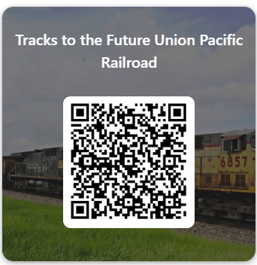
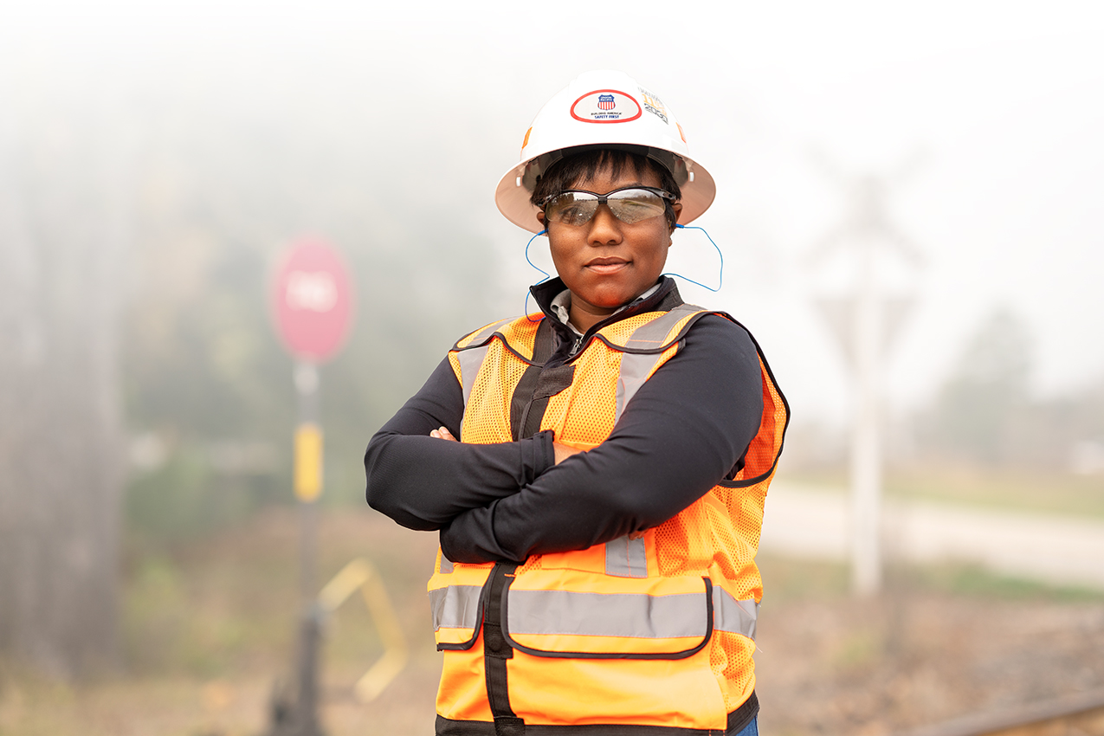
TRACKS TO THE FUTURE
Union Pacific Railroad
Union Pacific Railroad
May 16, 2025, • 9:00 AM – 2:00 PM
IowaWorks
200 Army Post Rd
Des Moines, Iowa 50315
Agenda of Events
Introduction to UP local Leadership Networking with other Community Partners
Overview of Operating Functions Workforce Development & Careers
Employee Resource Groups
Safety Initiatives
Roundtable Discussions
If you have questions, please email
Ken Kuwamura
krkuwamu@up.com
Evy Olsen
Elolsen@up.com
Rhonda Harvey
Rhonda.harvey@up.com
https://forms.office.com/r/ywM7QEE2SU

